Slide 1
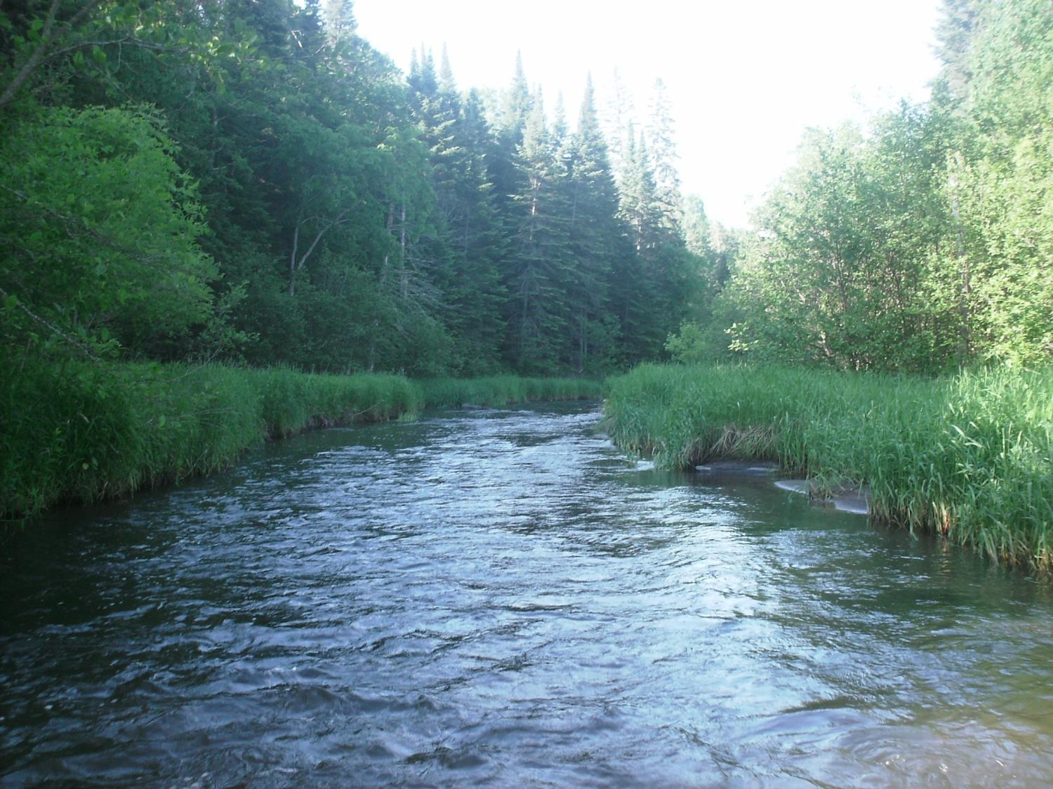
Legislative Water Commission
2019 Recommendation Feedback
“Desired Future State for Water”
Co-chairs: Senator Wiger Representative Torkelson
Jim Stark, Director
Straight River, Becker County
1

Slide 2
Introductions
LWC members
Legislators
Abra Pollock (MMB)
Kasey Gerkovich
Jim Stark
2

Slide 3
Legislative Water Commission
REVIEW-state agencies’ water policy reports & recommendations
GATHER- data and comments
LEGISLATIVE RECOMMENDATIONS: Assist legislature in formulating legislation
SHARE-data & information with LCCMR, CWC, legislative standing committees, upon request
COORDINATE-with the CWC

Slide 4
How can the recommendations be used?
Propose/promote/support legislation
Resource for stakeholders regarding legislative initiatives
Recommendations to guide or suggests programs/planning/funding:
LCCMR
CWC
LSOHC
Agencies

Slide 5
LWC: 12 Members
Body | First Name | Last Name | Party | District | Home
Sen | Paul | Anderson | R | 44 | Plymouth
Rep | David | Bly | DFL | 20B | Northfield
Sen | Rich | Draheim | R |  | Madison Lake
Sen | Kent | Eken | DFL | 4 | Twin Valley
Rep | Peter | Fischer | DFL | 43A | Maplewood
Rep | Glenn | Gruenhagen | R | 18B | Glencoe
Sen | Jason | Isaacson | DFL | 19A | Shoreview
Rep | Clark | Johnson | DFL | 19A | N. Mankato
Rep | John | Poston | R | 9A | Lake Shore
Rep | Paul | Torkelson* | R | 16B | Hanska
Sen | Bill | Weber | R | 22 | Luverne
Sen | Chuck | Wiger* | DFL | 43 | Maplewood

Slide 6
Agenda
Overview of possible 2019 Issues
Describe Today’s Issue and Recommendations
Small Group Review/Report-Out
Next Steps

Slide 7
2019 Recommendations
Six Issues with recommendations:
Based on:
LWC guidance
Stakeholder advice
Review of many plans/documents

Slide 8
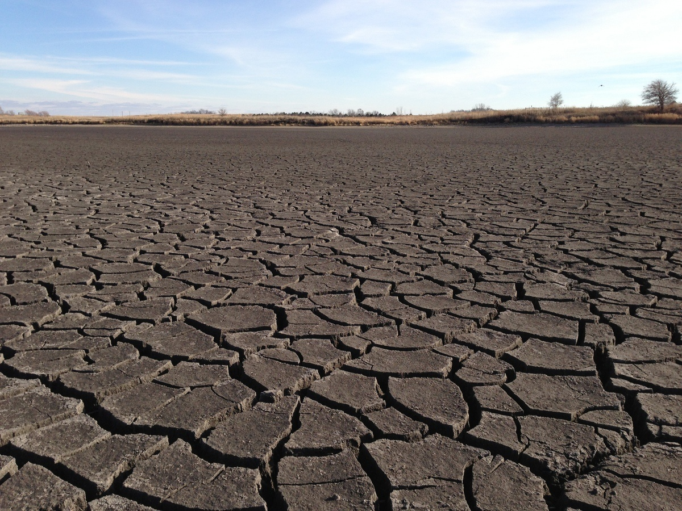
A Firm Foundation
1989- GW Act
1999- USGS Sustainability Report
2004- G16 Impaired Waters Plan (MPCA)
2005- DNR/GW Report
2006- Clean Water Legacy Act
2006- ENRTF Sustainability Report
2008- Clean Water Amendment
2008 Legislative Water Sustainability Framework
2009- EQB Sustainability Report
2012- GW Management Area Plans (DNR)
2017- Freshwater Society Reports on Water Sustainability
(Worthington, MN-2012)

Slide 9
Six Issue Areas
9

Slide 10
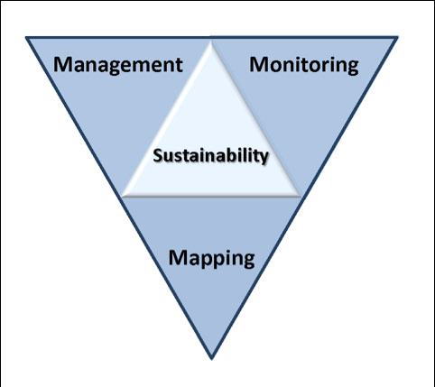
2019 LWC Issues and Recommendations
Wastewater*
Drinking water*
Groundwater
Sustainable Lakes
Water retention
Future state
* Short term
Notes:
Protection of ground water and surface water resources will require substantial investments from a diversity of funding sources over all levels of government during the next decade. As a part of this effort, this program of mapping, monitoring and managing is necessary to deliver the basic understanding of the hydrologic system for both surface and groundwater.

Slide 11
Today’s Issue:
Minnesota’s Desired “Future State for Water”
11

Slide 12
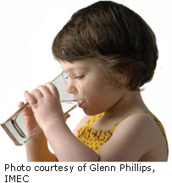
Minnesota’s Desired Future State for Water
* Think long term
* What water legacy would
you like your
grandchildren?
* Maintain what we have? * Improve?
* Protect some aspects?
* Set priorities/make choices?
* Enhance/improve upon
today’s conditions? * Legacy Amendment a success?
Notes:
What we hope to leave you with is a much better understanding of our state’s groundwater resources and appreciation for the challenges we face.
Simply stated the problem we are increasingly recognizing is that there are ….

Slide 13
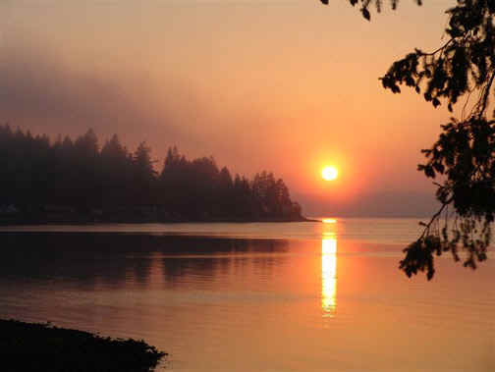
Future State: What are the Issues?
Legacy Amendment has been transformational!
Much has been accomplished
At the half-way point
Will water improvements may not meet citizen expectations?
Monitoring and evaluation
are well underway
Time to reflect adjust
Notes:
For more information and real time monitoring data you can visit this web site.

Slide 14
Future State– Issues (2)
Citizens, Admin, Legislature, LCCMR, CWC, LSOHF all have roles
Now may be time to reflect and refocus
Balance long and shot term goals
Move more to implementation
Find a balance between conservation, protection, and the economy
Prioritize our water resources?
Think long term
Notes:
For more information and real time monitoring data you can visit this web site.

Slide 15
What can we do?
Focus on implementation
Determine our future state
Balance protection, preservation and improvement
Make hard decisions about what can
be done and how it can be funded- Prioritize
Create protected status for features?
Enhance conservation easements
Plan for the end of the amendment
Notes:
For more information and real time monitoring data you can visit this web site.

Slide 16
Recommendations: Future State (1)
Water bank accounts
Locally-led water management.
Control invasive species
Understand ecosystem services
Enhance water appropriation
Increase public education
Control emerging contaminants
Increase information and analysis
Increase knowledge about water supply

Slide 17
Recommendations: Future State (2)
Recharge and re-use of excess water
Keeping water on the land
Aging infrastructure
Plan for an uncertain future
Protect lakes
Protect rivers/groundwater
Implement water policy
Recognize the full value of water
Water quality degradation

Slide 18
Today’s Request:
Small groups
Review issues/recommendations
Missing issues?
Missing stakeholders?
Rank issues (H/L)
Seeking your input--not consensus
Will revisit issues later
18

Slide 19
Resources:
Recommendations
Background issue paper- draft
Notes:
For more information and real time monitoring data you can visit this web site.

Slide 20
Small Group Exercise
Discuss recommendations
What’s missing?
Who’s missing?
Rank (H,L)
Are they actionable- Move the needle?
Appropriate for Legislation/ Funding/Agency or Stakeholder Resource?
Consensus
Report back:
Top issues (1-2) and missing issue
40 minutes
Notes:
For more information and real time monitoring data you can visit this web site.

Slide 21
Outcome for today: an example –drinking water
Improve monitoring/ information/education/mitigation of contaminants Increase investment in drinking water infrastructure
Increase support for source-water protection
Increase the MDH drinking water hook-up fee.
Monitoring to detect potential threats to water supplies
Assess/invest in water asset management plans
Implement the groundwater protection rule
Embrace new technology for drinking
Identify location/condition of failing septic systems
Legislation: failing homes and businesses wastewater systems.
Legislation: return provision for pharmaceuticals
Funds to assess viruses
Legislation: surface water/source water protection
Suggested: Adopt risk-based management of drinking water threats
Suggested: Revise statutes/improve agency management of water

Slide 22
Next Steps
Complete Issue papers
Revise recommendations based on your input
Feedback from LWC Members
Additional Feedback from Stakeholders
Final consensus by LWC
Recommendations to Legislature- before session
Legislative Briefings with Committees

Slide 23
Small Group Exercise
Discuss recommendations
What’s missing?
Who’s missing?
Rank (H,M,L)
Are they actionable- Move the needle?
Appropriate for Legislation/ Funding/Agency or Stakeholder Resource?
Report back:
Top issue and most important missing issue
40 minutes
Notes:
For more information and real time monitoring data you can visit this web site.

Slide 24
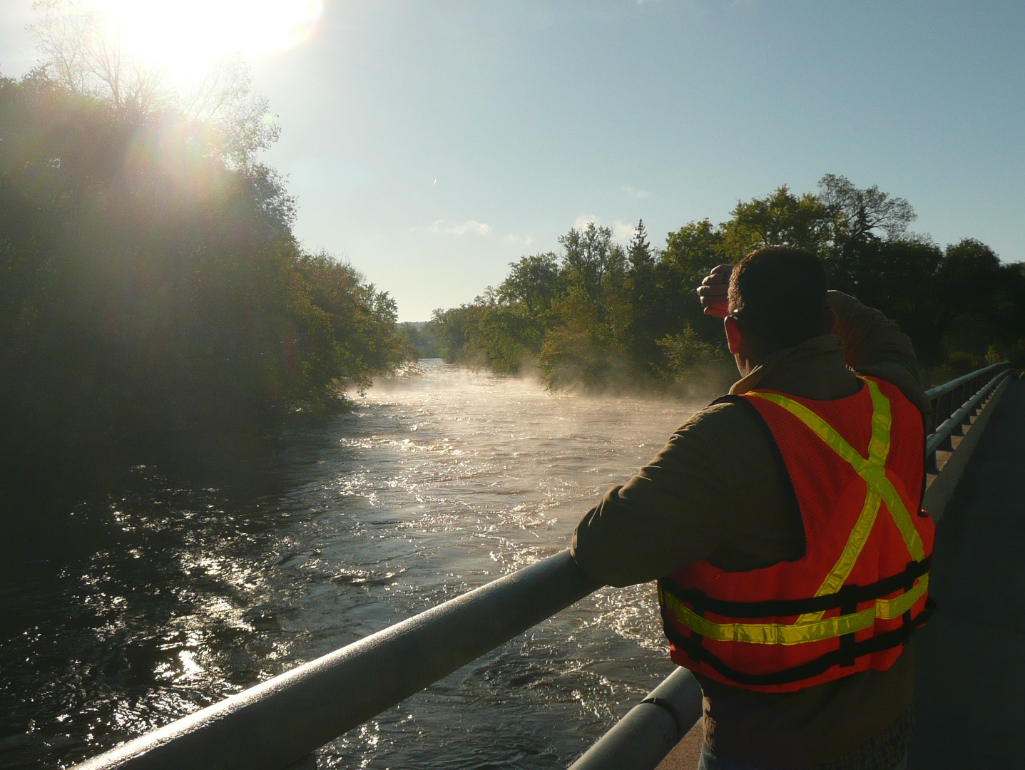
Thank You

Slide 25
Next Steps
Please turn in your spreadsheet (1 per group)
Revise Issue Statements
Revise Recommendations
Initial Consensus from LWC
Feedback from Stakeholders
Final consensus by LWC -November
Recommendations to Legislature
Legislative Briefings with Committee

Slide 26
Thanks!
Notes:
For more information and real time monitoring data you can visit this web site.

